Slide 1

Capstone project
Python Bootcamp Data Analysis for Beginners
Team-9: @Lena Fidrmuc
@Ullien
@Chinnie

Slide 2
Data
Life expectancy by WHO
Health indicators
BCG coverage by WHO:
Bacillus Calmette–Guérin(BCG) vaccine is a vaccine primarily used against TB
Covid-19 data by Worldometers

Slide 3
Questions
Do countries with higher life expectancy suffer more from Covid-19 in terms of deaths recorded?
Do countries where BCG vaccine was widely implemented have fewer infection rates per million?
Do countries where BCG vaccine was widely implemented have higher life expectancy?
What is the most Covid-19 affected continent in terms of infected cases and deaths?
What country has the highest ratio of recovered cases?

Slide 5
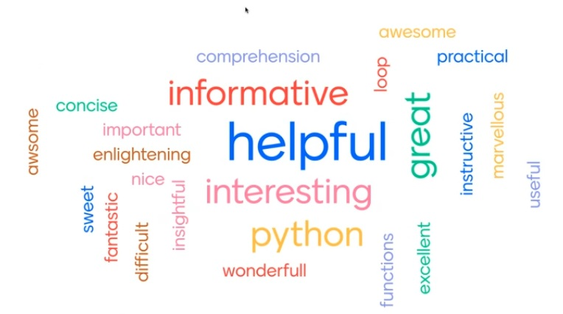
Thank you To Pyladies Amsterdam!

